Slide 1

Does culture eat strategy for breakfast?
How to build a winning digital strategy and team.
Josh Clarkson
Director of Digital - Russell Stover Chocolates

Slide 2


Slide 3


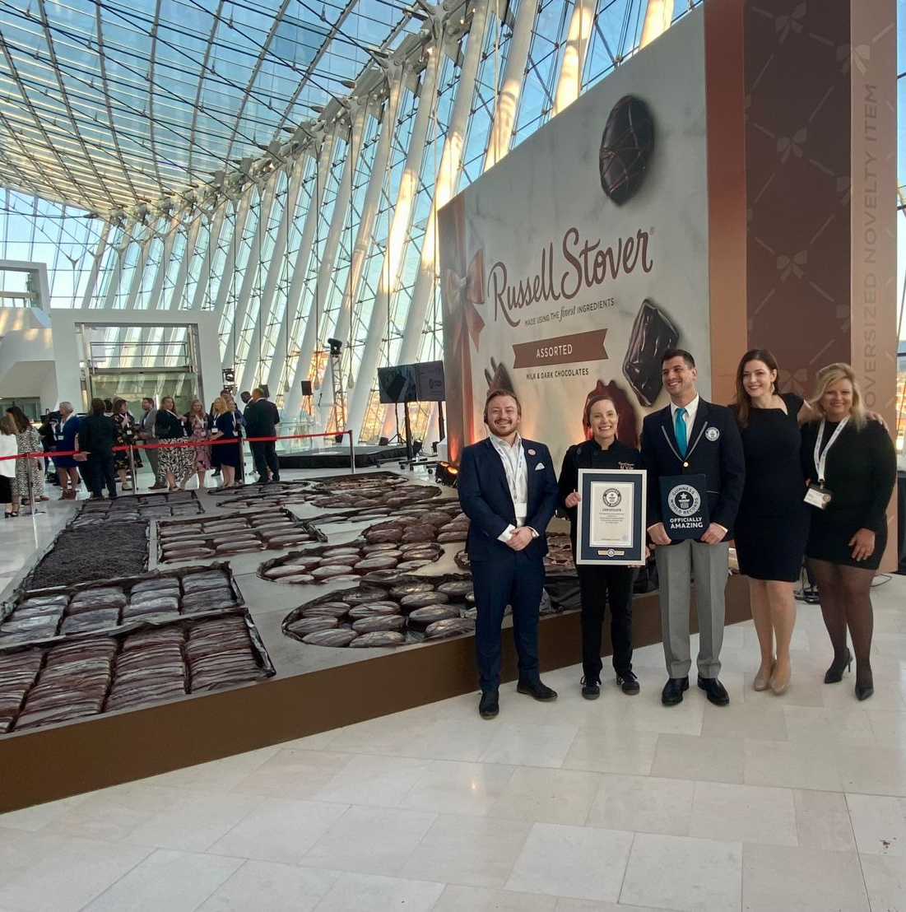
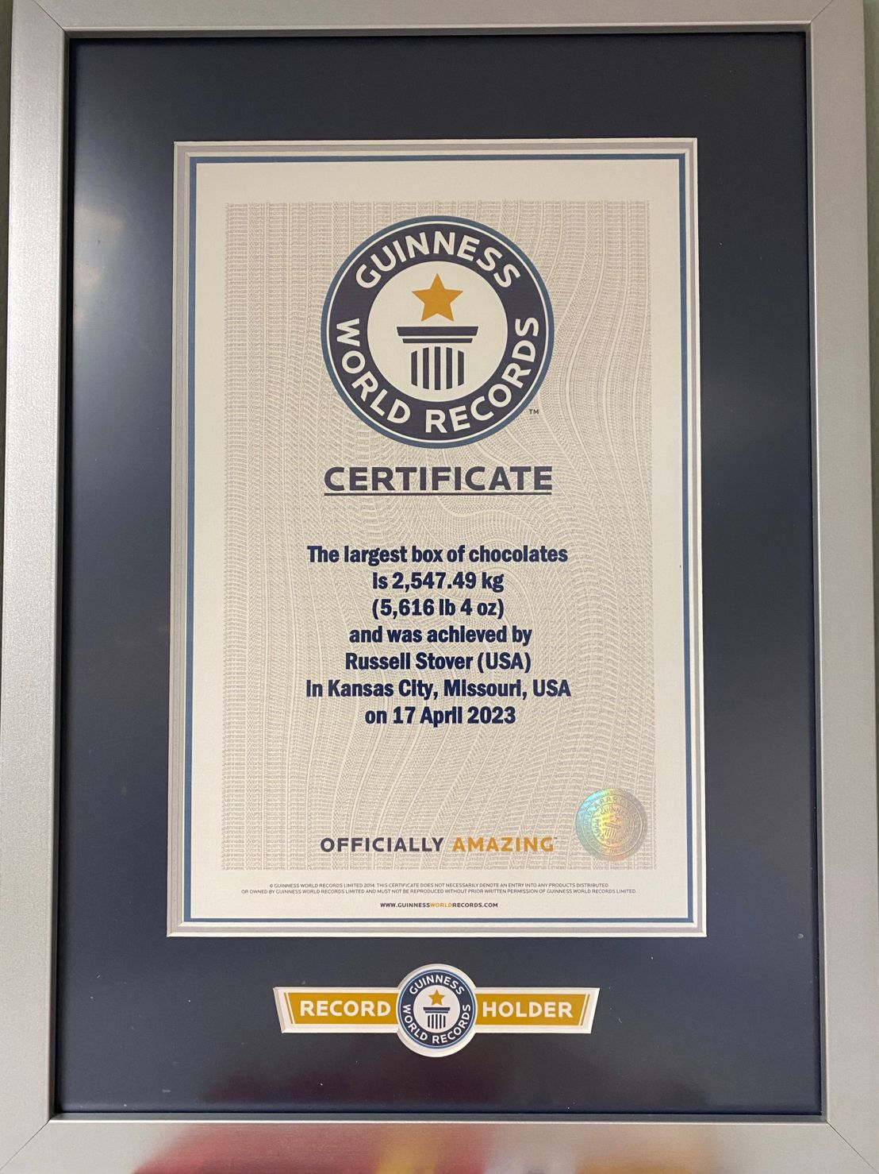
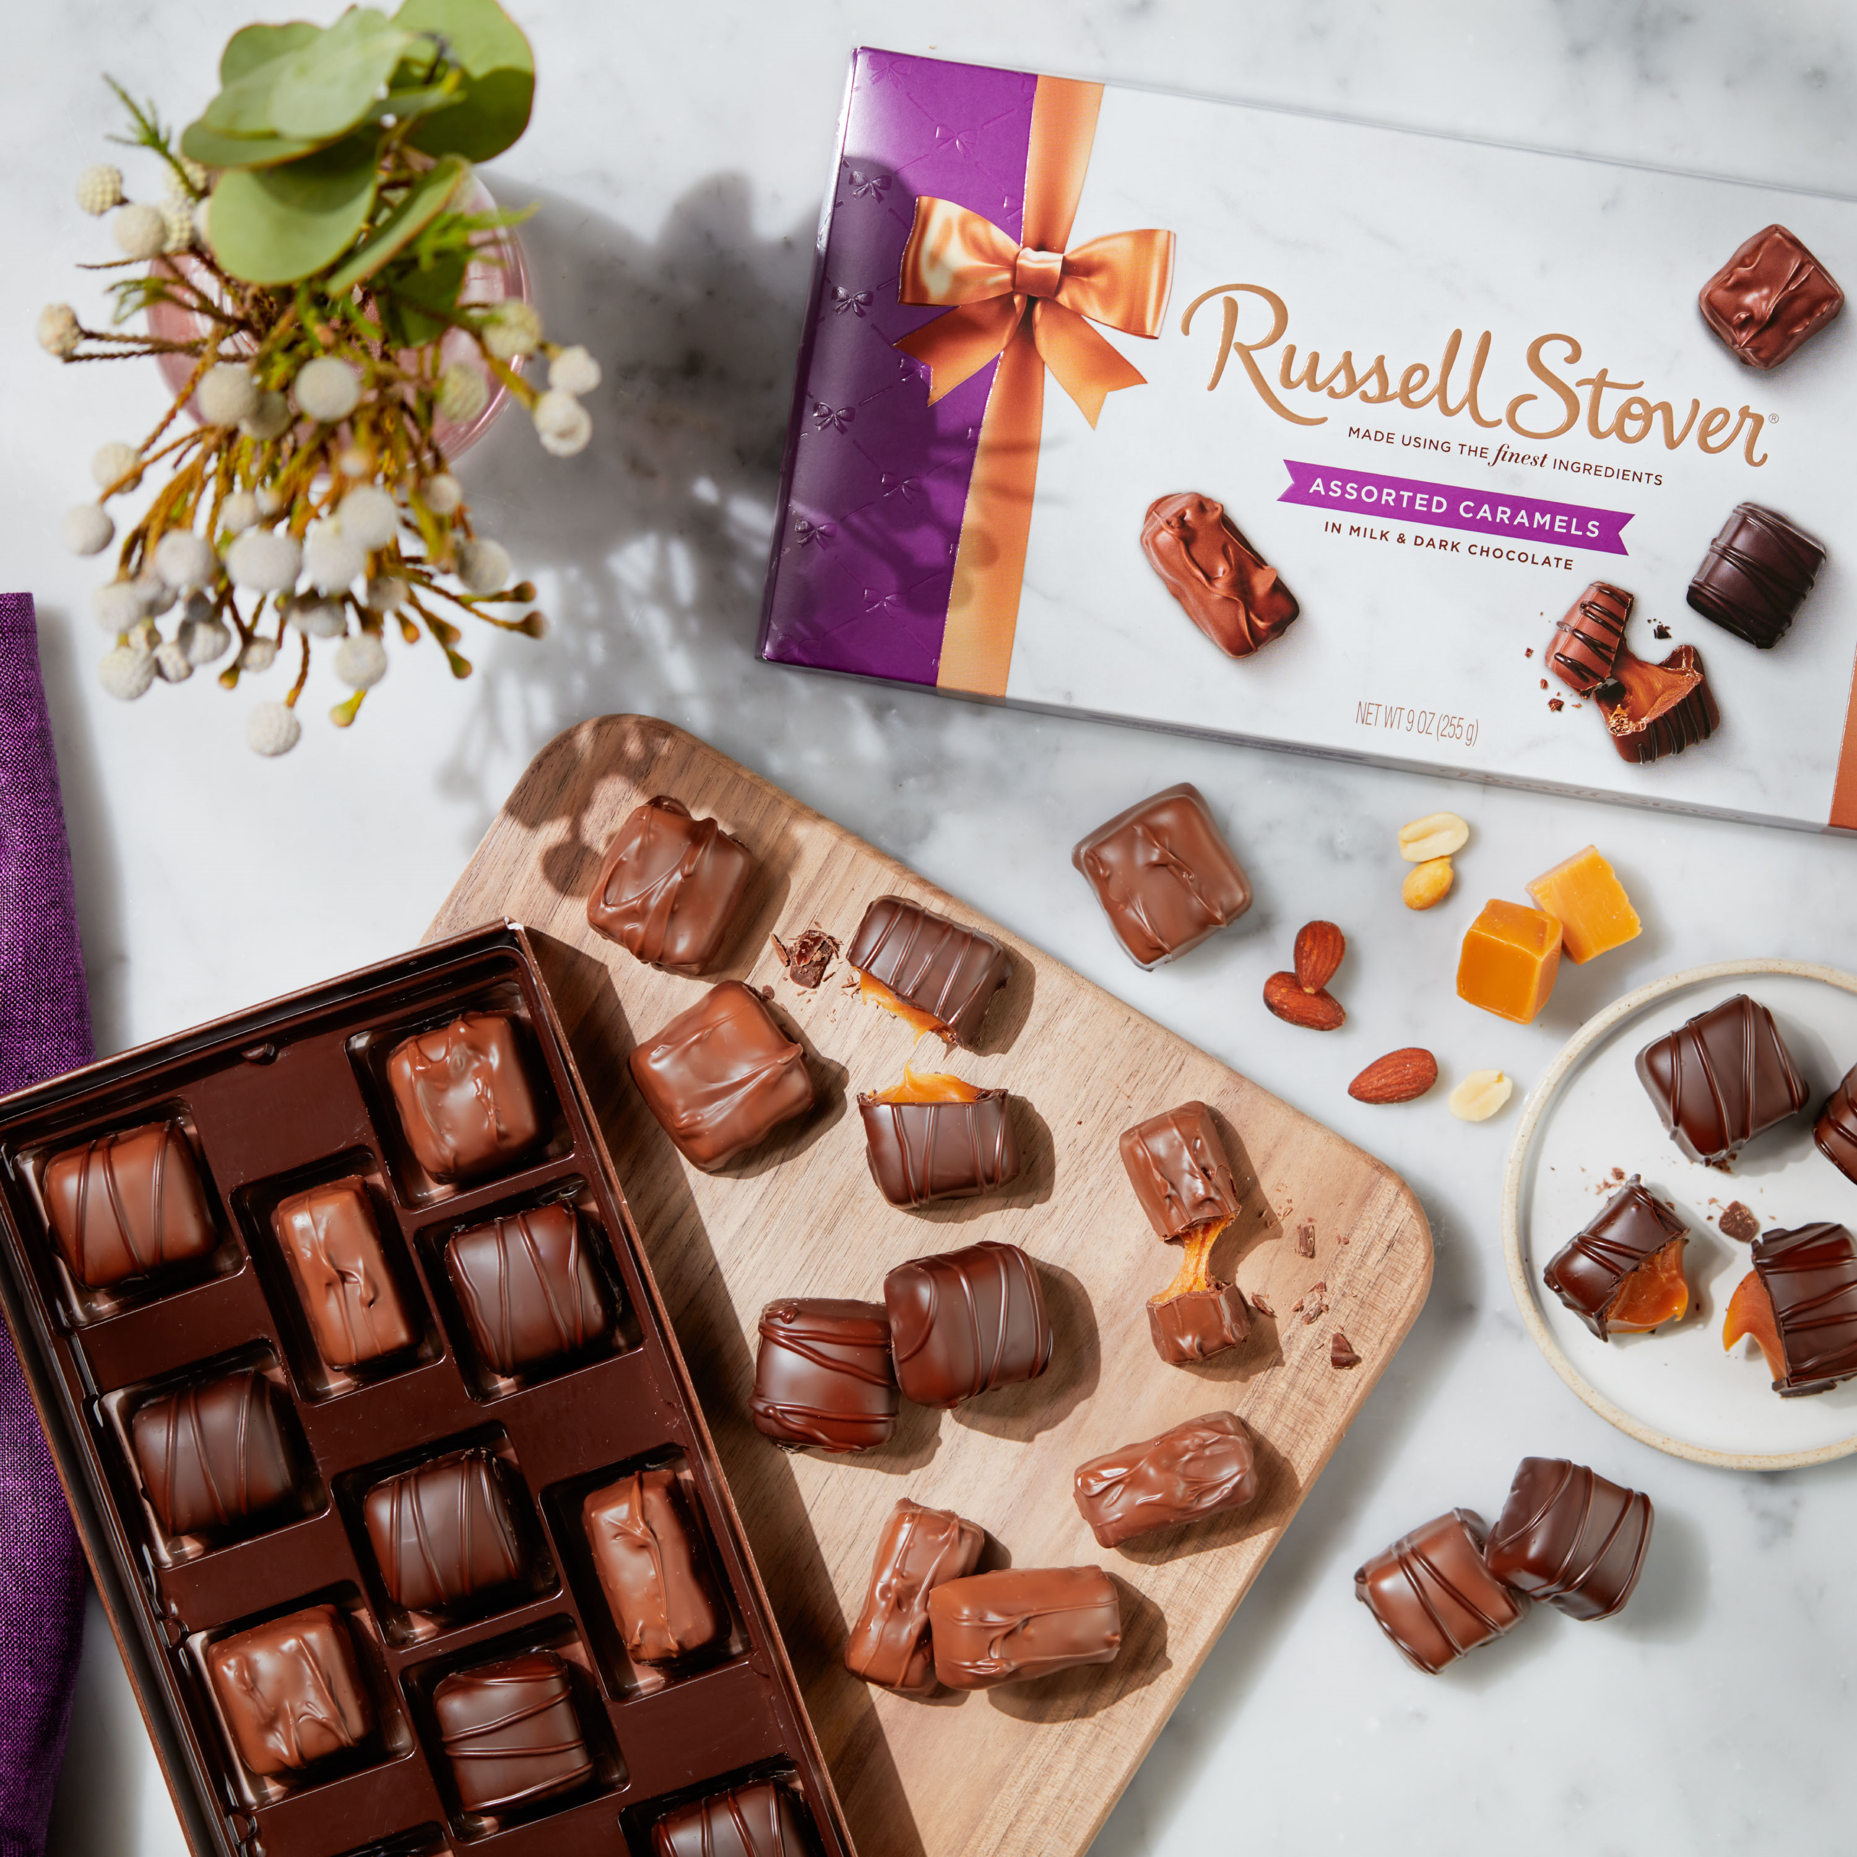


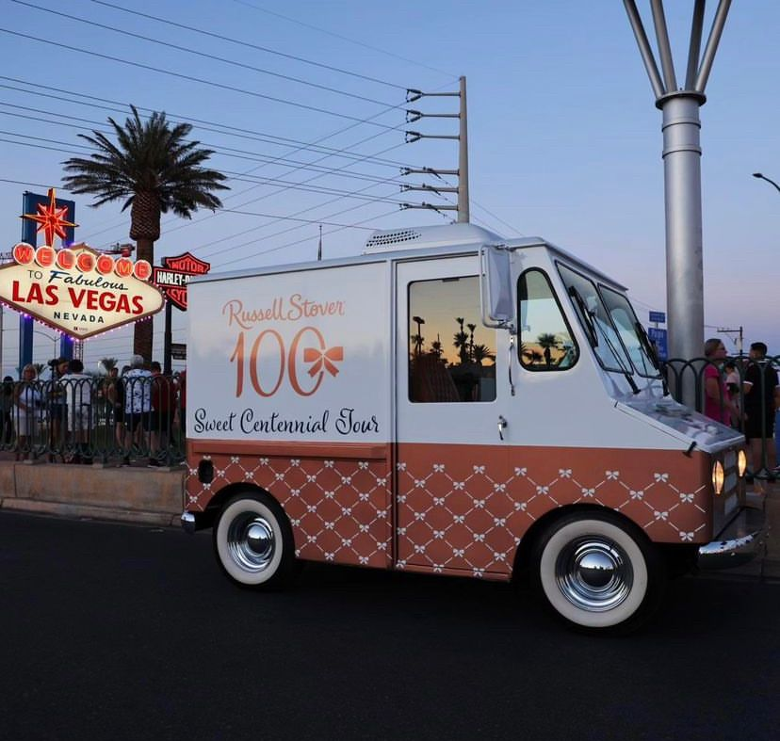



Slide 4
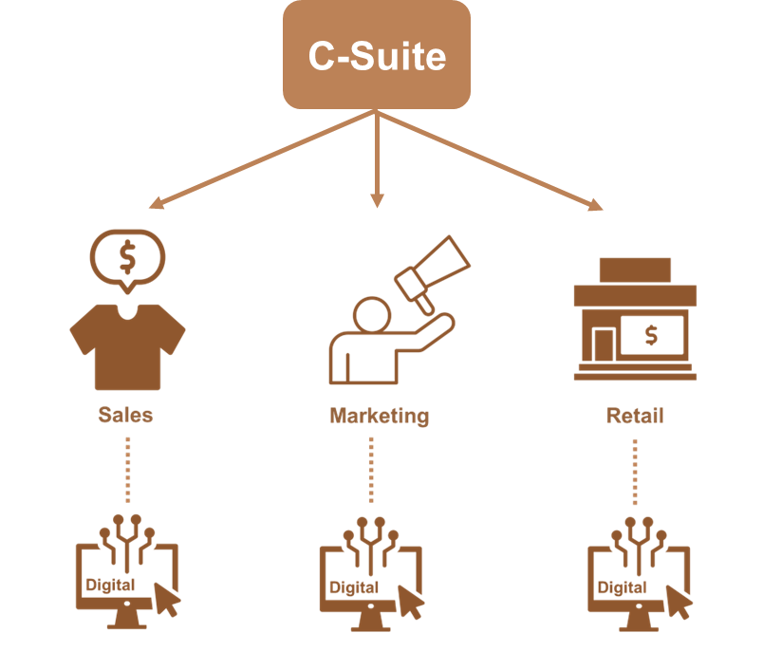
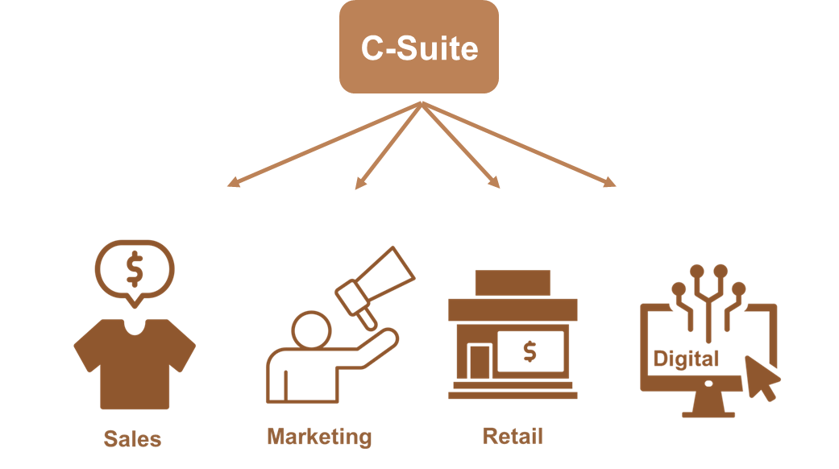

Slide 5
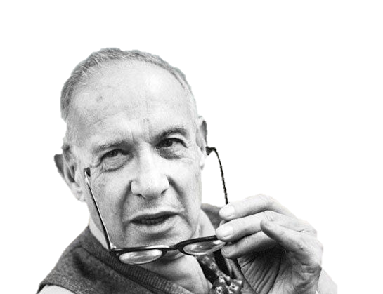
CULTURE
STRATEGY
Peter Drucker

Slide 6



S.T.A.R.S.
C.O.M.P.A.S.S.

Slide 7


Slide 8
“Do we make money…?”
“Are we there…?”
“Will they buy us…?”
“Can they find us…?”

Slide 9
Online Market share = Total Market share
Become the #1 gifting and guilt-free treating brand online
Build an $XXXm Digital Business with YY% GP

Slide 10
Online Market share = Total Market share
Become the #1 gifting and guilt-free treating brand online
Build an $XXXm Digital Business with YY% GP
AVAILABILITY
VISIBILITY
CONVERSION
MANAGEMENT

Slide 11

(1)
AUDIENCE

Slide 12
Online Market share = Total Market share
Become the #1 gifting and guilt-free treating brand online
Build an $XXXm Digital Business with YY% GP
AVAILABILITY
VISIBILITY
CONVERSION
MANAGEMENT
Right Product (Innovation)
Right Place (Operations)
On Site (Sales/Mktg)
Off Site
(Media/Mktg)
Content (Creative/MD)
Value (Analytics)
Direct
(RGM)
Indirect (Finance/HR)

Slide 13

THE BIG
(2)
THE SMALL

Slide 14
+100%
(2)
+1-5%

Slide 15
Online Market share = Total Market share
Become the #1 gifting and guilt-free treating brand online
Build an $XXXm Digital Business with YY% GP
AVAILABILITY
VISIBILITY
CONVERSION
MANAGEMENT
Right Product (Innovation)
Right Place (Operations)
On Site (Sales/Mktg)
Off Site
(Media/Mktg)
Content (Creative/MD)
Value (Analytics)
Direct
(RGM)
Indirect (Finance/HR)
GA/SEO optimisation
Relocation of D2C fulfilment
Local KAM scorecarding
DAM & PIM launch

Slide 16
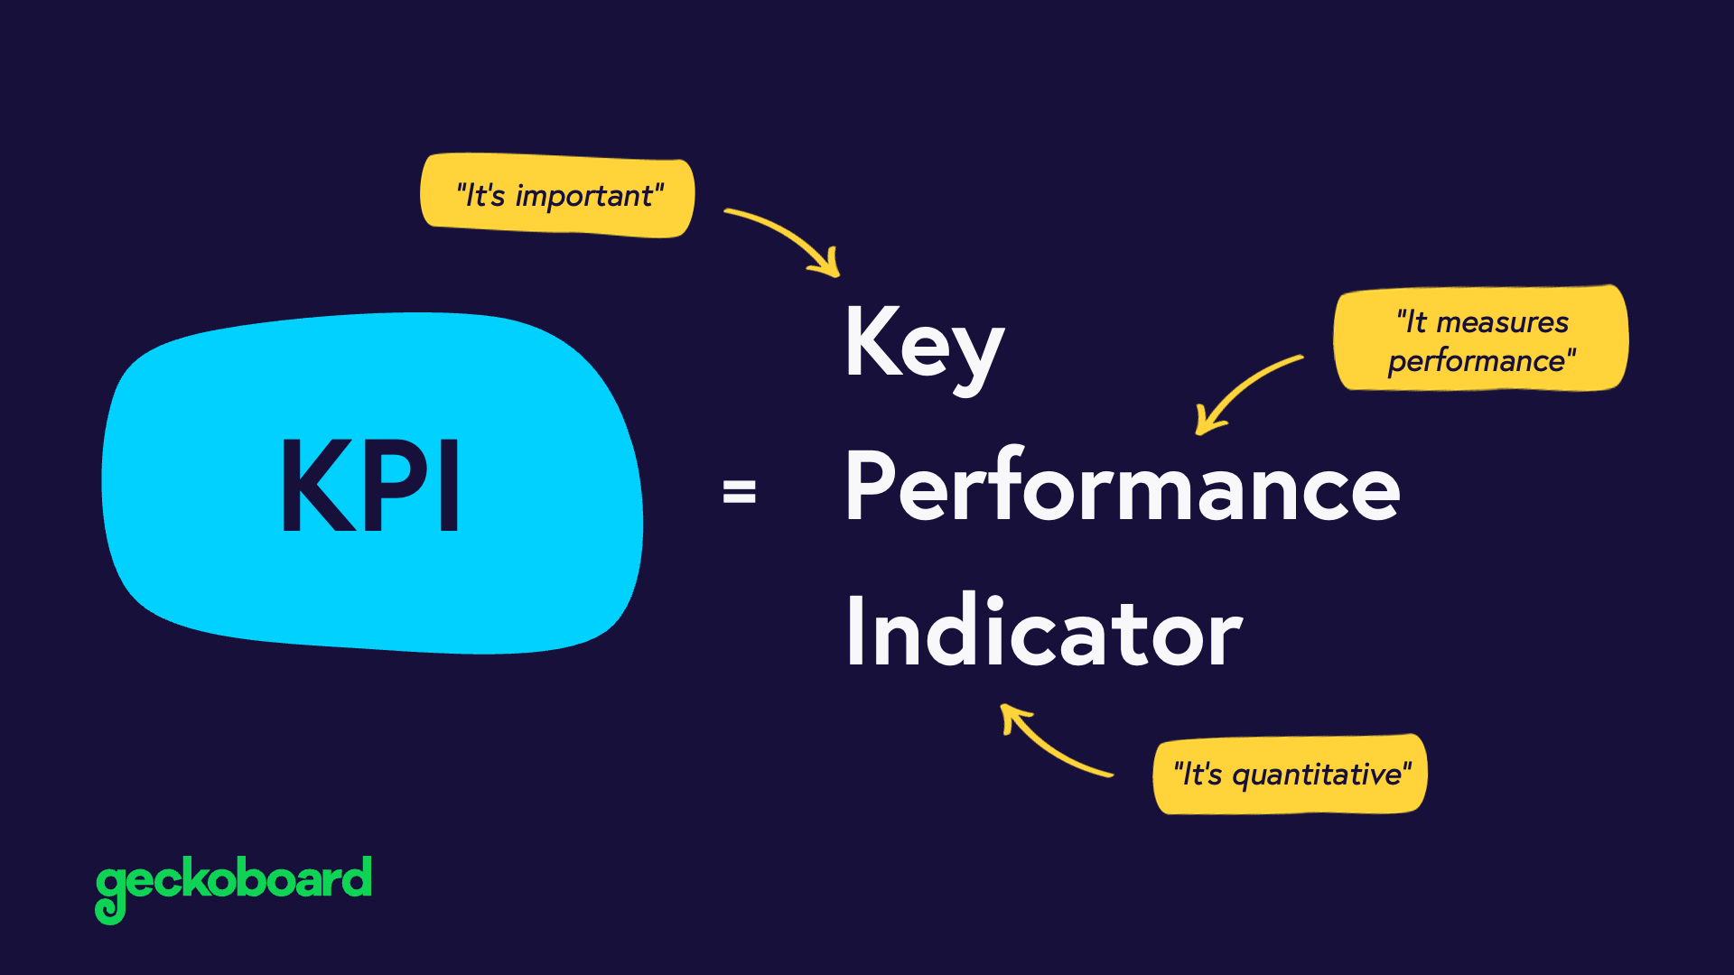
(3)

Slide 17
Online Market share = Total Market share
Become the #1 gifting and guilt-free treating brand online
Build an $XXXm Digital Business with YY% GP
AVAILABILITY
VISIBILITY
CONVERSION
MANAGEMENT
Right Product (Innovation)
Right Place (Operations)
On Site (Sales/Mktg)
Off Site
(Media/Mktg)
Content (Creative/MD)
Value (Analytics)
Direct
(RGM)
Indirect (Finance/HR)
GA/SEO optimisation
Relocation of D2C fulfilment
Local KAM scorecarding
DAM & PIM launch
OOS < XX%
Share of Search = XX%
Conversion > XX%
Full team, syndication & P&Ls. Engagement score > 80%
Data → Insight → Action → Analyse → Adjust & Share

Slide 18












Josh Clarkson
Director of Digital
eCommerce Business Analyst
Digital Marketing Manager
Social Media Intern
C2M
eCommerce Manager
Marketplace Manager
D2C
eCommerce Manager
Digital Shelf Executive
.com
PURE PLAY (PP)
CLICK TO CONSUMER (C2C)
CLICK TO MORTAR (C2M)

Slide 19
AVAILABILITY
VISIBILITY
CONVERSION
MANAGEMENT
Josh Clarkson
Director of Digital
eCommerce Business Analyst
Digital Marketing Manager
Social Media Intern
C2M
eCommerce Manager
Marketplace Manager
D2C
eCommerce Manager
Digital Shelf Executive
Direct
(RGM)
Indirect (Finance/HR)
.com
PURE PLAY (PP)
CLICK TO CONSUMER (C2C)
CLICK TO MORTAR (C2M)
Right Place (Operations)
Off Site
(Media/Mktg)
On Site (Sales/Mktg)
Right Product (Innovation)
Value (Analytics)
Content (Creative/MD)

Slide 20

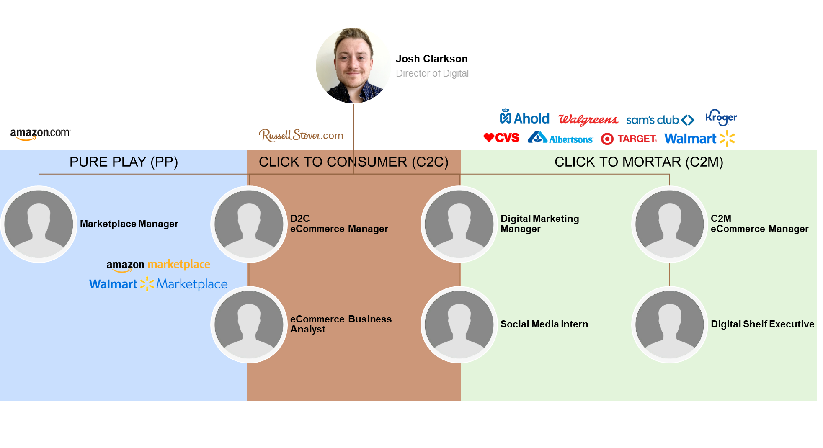
CEO
Retail
CFO
Creative
CMO
Brand Managers
Warehousing
Agency Partners
Logistics
International eCommerce
Supply Chain

Slide 21
Online Market share = Total Market share
Become the #1 gifting and guilt-free treating brand online
Build an $XXXm Digital Business with YY% GP
AVAILABILITY
VISIBILITY
CONVERSION
MANAGEMENT
Right Product (Innovation)
Right Place (Operations)
On Site (Sales/Mktg)
Off Site
(Media/Mktg)
Content (Creative/MD)
Value (Analytics)
Direct
(RGM)
Indirect (Finance/HR)
GA/SEO optimisation
3 tier Digital education
Relocation of D2C fulfilment
Local KAM scorecarding
DAM & PIM launch
OOS < XX%
Share of Search = XX%
Conversion > XX%
Full team, syndication & P&Ls. Engagement score > 80%
Data → Insight → Action → Analyse → Adjust & Share

Slide 22


EVERYONE ELSE
(POTENTIALLY THE FUTURE DO-ERS)
WHAT are these acronyms?
WHAT is digital?
WHAT is the impact?
WHAT is the difference
between Amazon & TGT?

Slide 23

HOW do we setup for future success?
HOW do we currently operate?
HOW do we integrate?
HOW do we measure?
THE DO-ERS
EVERYONE ELSE
(POTENTIALLY THE FUTURE DO-ERS)
WHAT are these acronyms?
WHAT is digital?
WHAT is the impact?
WHAT is the difference
between Amazon & TGT?

Slide 24

WHY is Digital important
WHY do we have the structure we have?
WHY do we need more resource?
WHY do we need to invest?
THE DECIDERS
HOW do we setup for future success?
HOW do we currently operate?
HOW do we integrate?
HOW do we measure?
THE DO-ERS
EVERYONE ELSE
(POTENTIALLY THE FUTURE DO-ERS)
WHAT are these acronyms?
WHAT is digital?
WHAT is the impact?
WHAT is the difference
between Amazon & TGT?

Slide 25
THE DECIDERS
In person training facilitated by internal SMEs and global guest speakers
In person workshops facilitated by external and internal SMEs
THE DO-ERS
Online learning supported by L&D team / 3rd party
EVERYONE ELSE
(POTENTIALLY THE FUTURE DO-ERS)

Slide 26
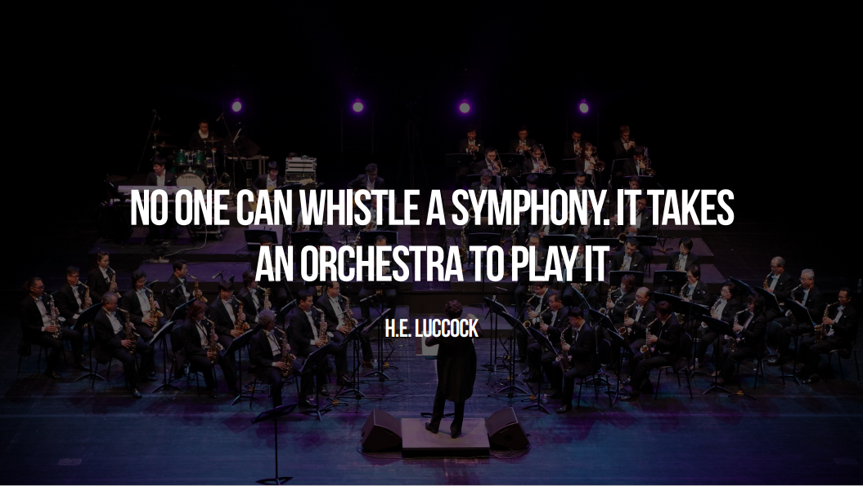

Josh Clarkson
Director of Digital - Russell Stover Chocolates

